Slide 1

Development of machine learning models to process Electronic Health Records – Explainable Models
Week 6 Meeting, 12/11/2021

Slide 2
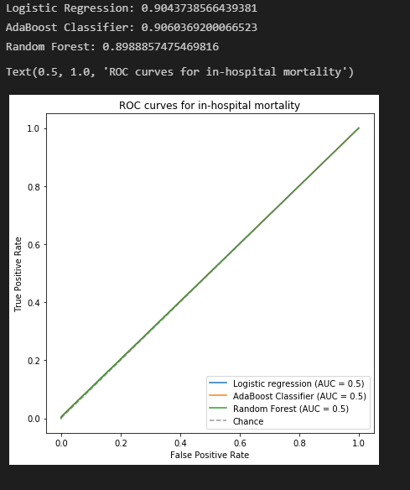

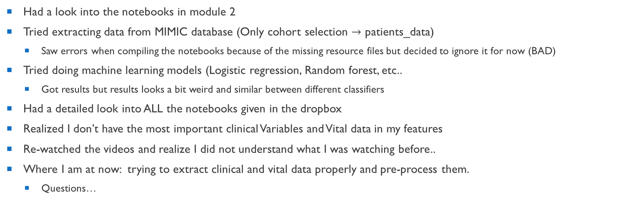
What I did.. (for the last week and a half)
Had a look into the notebooks in module 2
Tried extracting data from MIMIC database (Only cohort selection $→$ patients_data)
Saw errors when compiling the notebooks because of the missing resource files but decided to ignore it for now (BAD)
Tried doing machine learning models (Logistic regression, Random forest, etc..
Got results but results looks a bit weird and similar between different classifiers
Had a detailed look into ALL the notebooks given in the dropbox
Realized I don’t have the most important clinical Variables and Vital data in my features
Re-watched the videos and realize I did not understand what I was watching before..
Where I am at now: trying to extract clinical and vital data properly and pre-process them.
Questions…

Slide 3
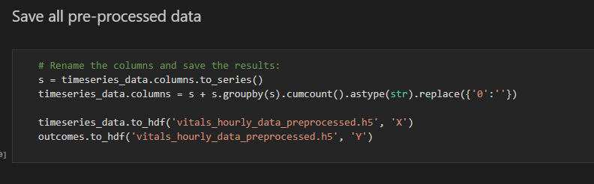
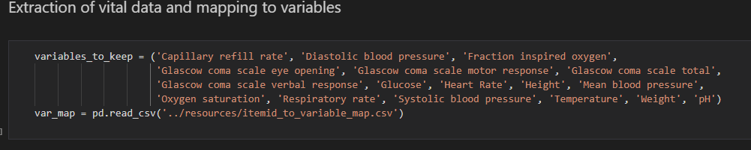

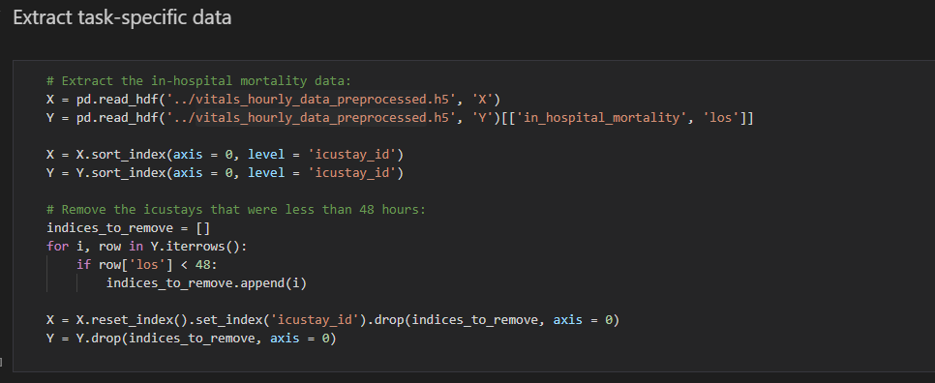
Difficulties faced when studying the notebooks
The notebooks often start with using already pre-processed data, but I have no clue how the data looks like without the file.
Tried looking through previous notebooks but could not find the source
(The resources tab on dropbox is all empty) maybe missing files?
preprocessing_steps.ipynb
extract_patients.ipynb
inhospital_mortality_OneHotEncoding_undersampling.ipynb

Slide 4
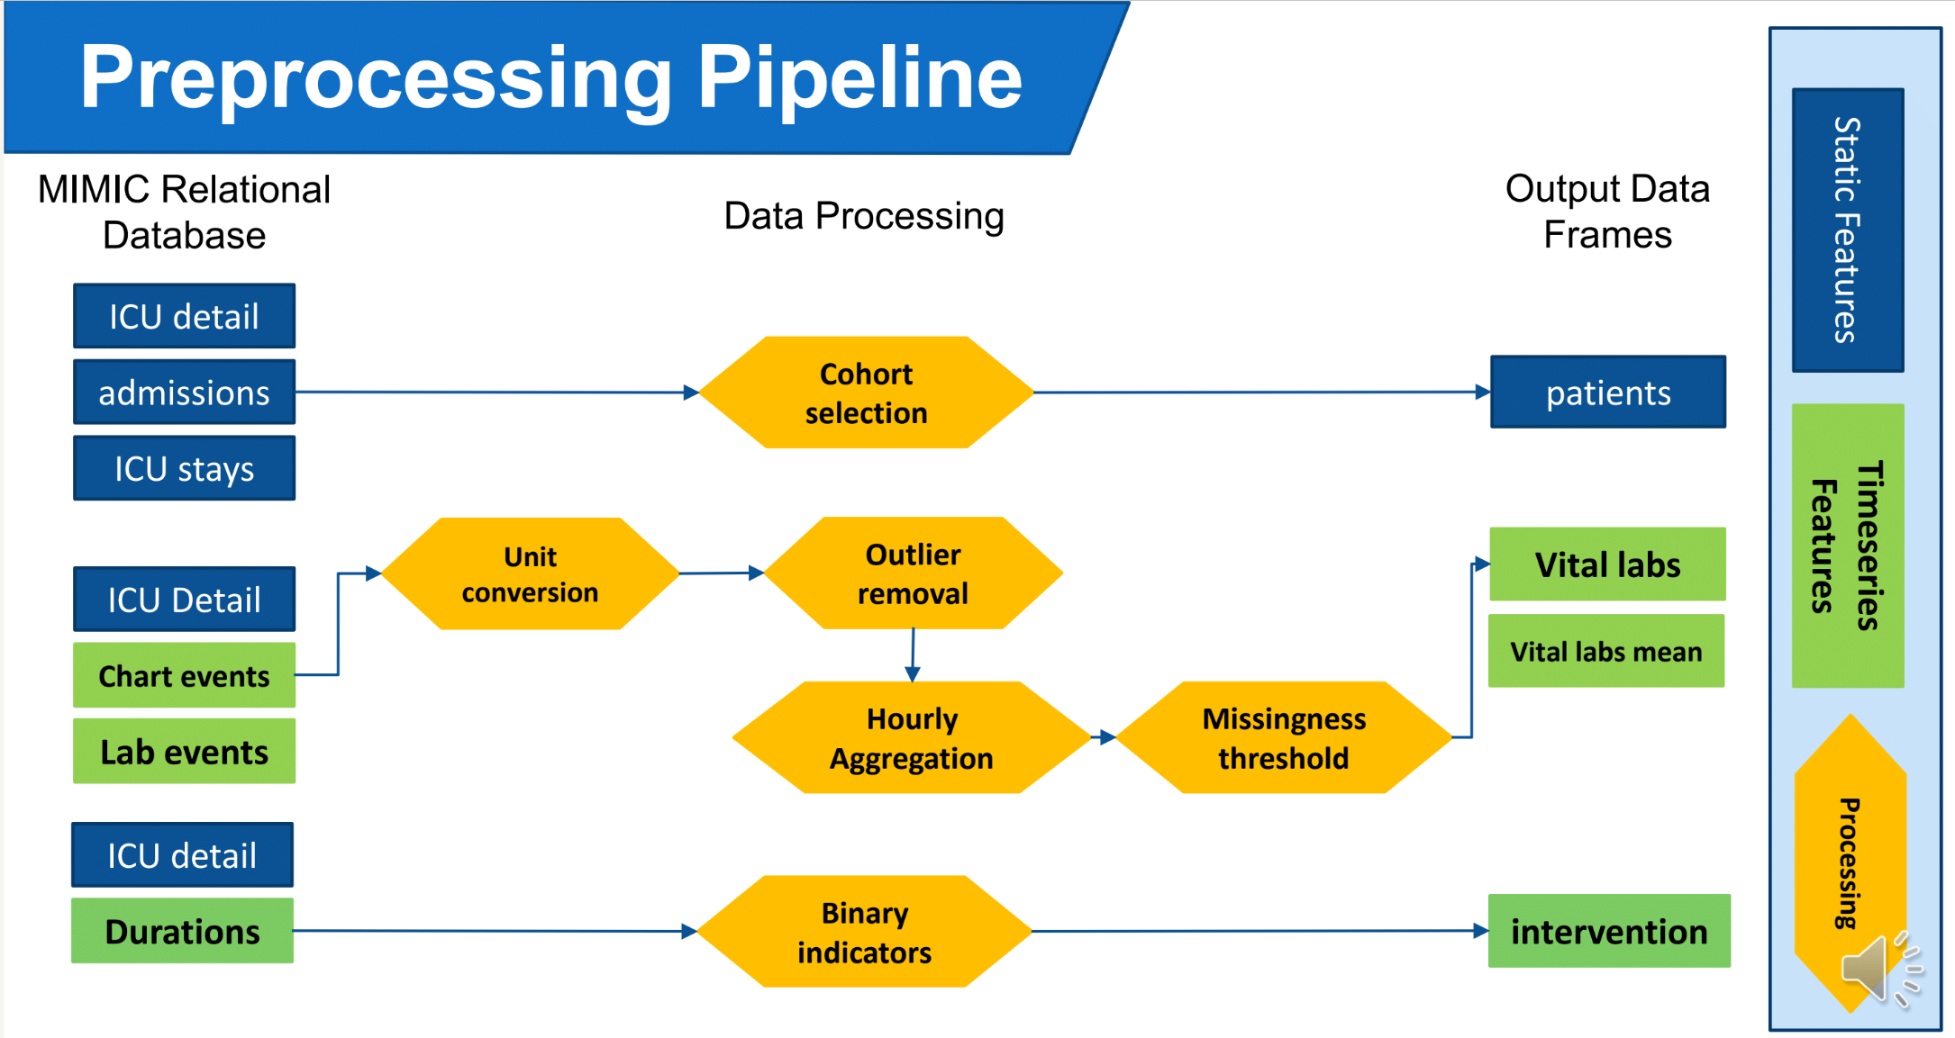
Questions on pre-processing pipeline
Tried to understand the pre-processing pipeline in detail
Should I be applying further pre-processing methods on static features? (ex. Normalisation, vectorisation, Scalers)
['gender', 'dob', 'dod', 'row_id', 'subject_id', 'hadm_id', 'icustay_id', 'dbsource', 'first_careunit', 'last_careunit', 'first_wardid', 'last_wardid', 'intime', 'outtime', 'los', 'admittime', 'dischtime', 'deathtime', 'ethnicity', 'diagnosis', 'hospital_expire_flag', 'hospstay_seq', 'hospital_los', 'icustay_seq', 'admission_age', 'los_icu’]
Should I care about how many features I have? Is too many bad?
Is the whole pipeline done in extract_patients.pynb?
Only applied machine learning on this part of the data

Slide 5
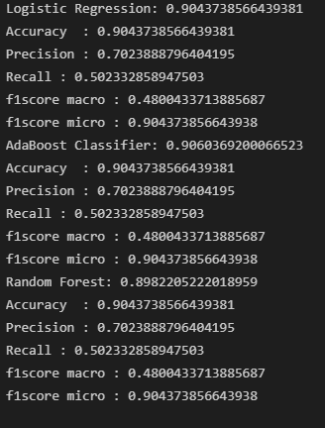

Slide 6
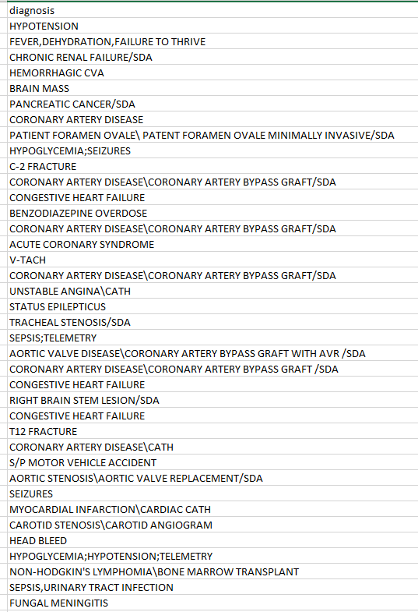
Pre-processing Example
Is it useful to do normalisation and vectorisation on columns like diagnosis and use as feature?
Should I be doing similar pre-processing steps for features in vital and clinical data necessary?
Is manual feature extraction not required at all for deep learning models?

Slide 7
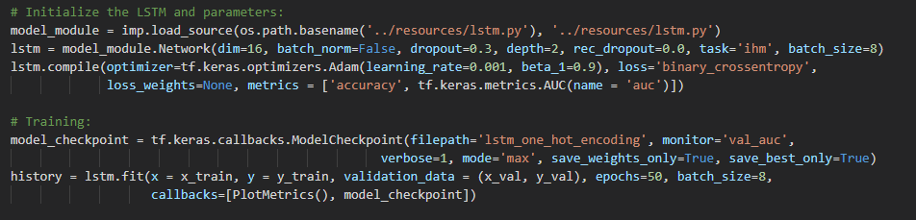
Questions on Deep learning
What is the lstm.py?

Slide 8
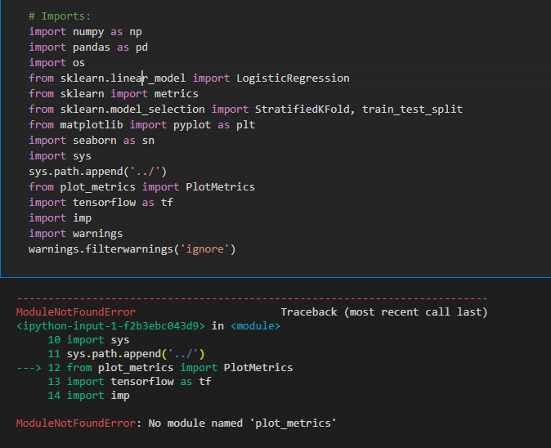
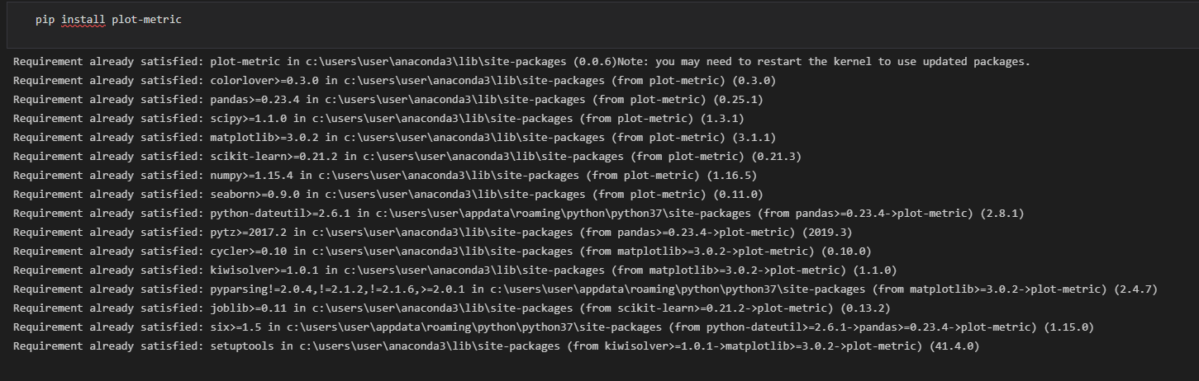
Could not install plot-metric
Can't find the module even after pip install
Is the sys.path.append suppose to do something to help locate them?

Slide 9
Question on scope of project
Is there a reason in not using regressive models in our research?
Rather than classifying as 0 and 1 we can predict a mortality rate between 0 to 1 based on the features given?
I have interest in creating an application based on the machine learning model trained using MIMIC data for daily clinical use.
Or for determining the emergency of ICU patients using the mortality rate generated to help prioritize cases with more emergency and higher mortality rate.

